Slide 1


Slide 2

Part 3:
Efficient Shadows from Many Lights
40 min
Ola Olsson
Chalmers University of Technology

Slide 3
Outline
Problem definition
Dynamic scenes
  Shadow maps
Static scene elements
  Other methods (too)

Slide 4
What’s the problem?
“Shadows for Many Lights”
  Can mean many different things!
  Each with many solutions.
Notes:
Shadows for Many Lights sounds like it might mean something, but
In fact it can mean very different things, that require very different solutions.

Slide 5
What’s the problem?
Not our problem:
  Very small and many lights
    Don’t need shadows.
Example:
Photon Splatting[8,9]
  Occlusion already computed
Notes:
For example, very small and numerous lights may not require shadow calculations at all.
An example of this is photon splatting, where occlusion resolved in the photon tracing.

Slide 6
What’s the problem?
Not our problem:
  Very small and many lights
    Don’t need visibility.
  Large lights with much overlap
    Can approximate visibility.
Example:
Imperfect Shadow Maps[8]
ManyLoDs[7]
Notes:
On the other hand, with many very large lights we can use approximate visibility
As errors average out, as it is called.
An example of where this is done is Virtual point lights.

Slide 7
What’s the problem?
Our problem: In between
  Current / Future games.
  Dynamic lights & scenes.
  100s of omnidirectional lights
    < Few 10s of lights per view sample.
  High-quality shadows
    No “averaging out” of errors.
  Real time
    At least “research real time”
Influence = 0
Falloff
Light Range
Influence = 1
Notes:
We aim for something like the numbers of lights and degree of overlap we might expect in modern games.
We also target fully dynamic environments, so nothing is precomputed.
The resulting numbers of lights per pixel implies that we must calculate high-quality shadows.
As there will not be enough overlap to hide errors.

Slide 8
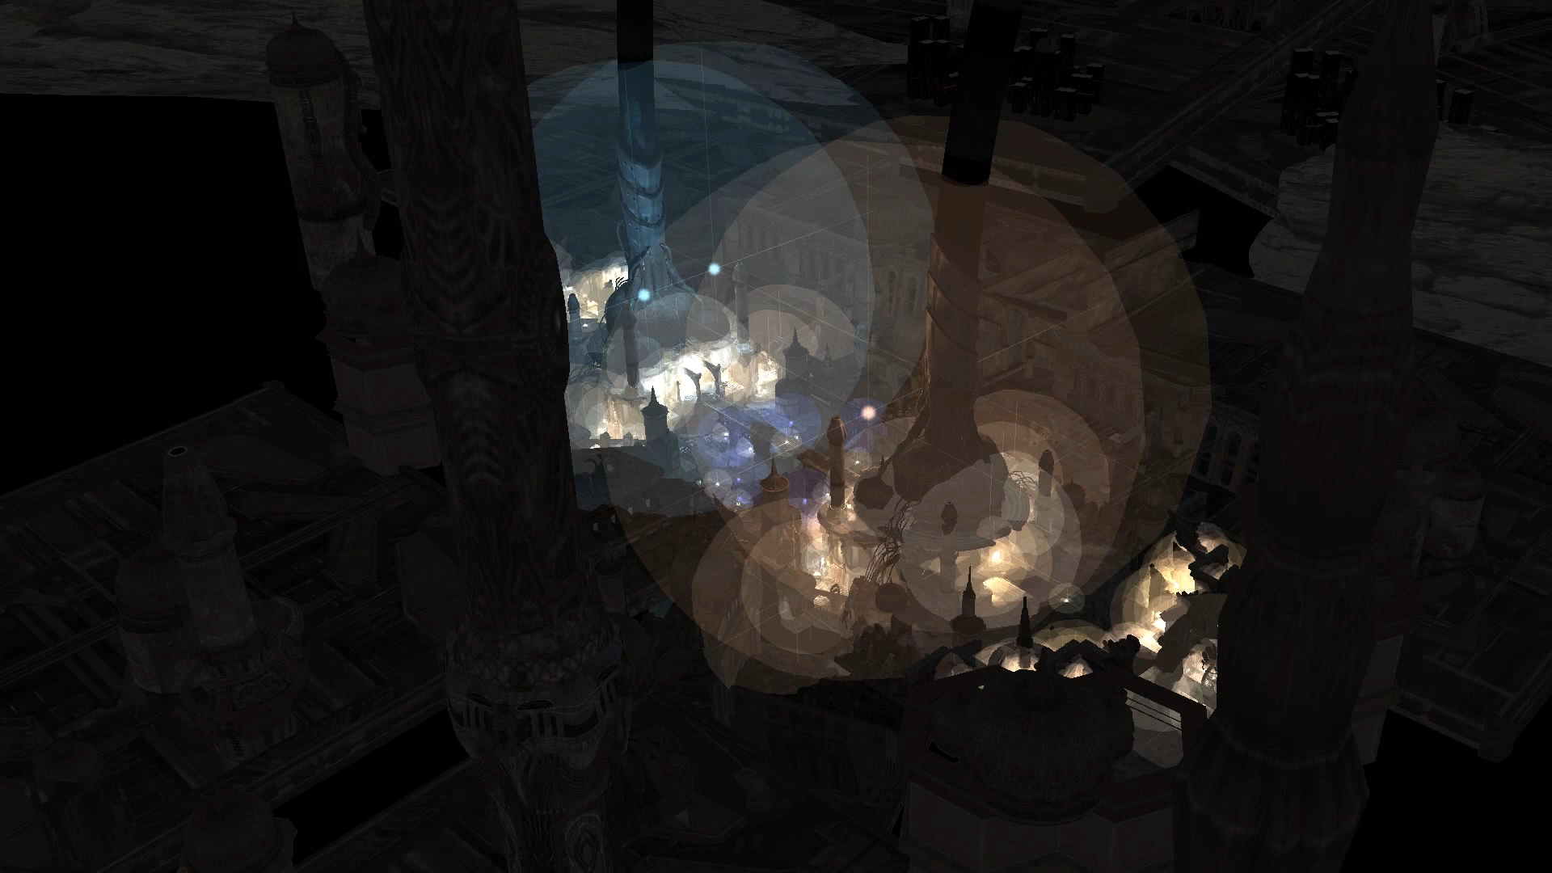
UKD Necropolis
~300-400 Lights
  Varying sizes
2.6M triangles
Min ≈30 FPS
Geforce Titan
Notes:
To illustrate what we are aiming for, here are some results from our paper
This scene contains almost 400 shadow casting, omnidirectional, point lights,
Some very large, most smaller.
All lights and geometry is treated as dynamic.
Even with almost 20 lights per pixel on average, we achieve…
…a minimum of around 30 fps on a Titan GPU.

Slide 9
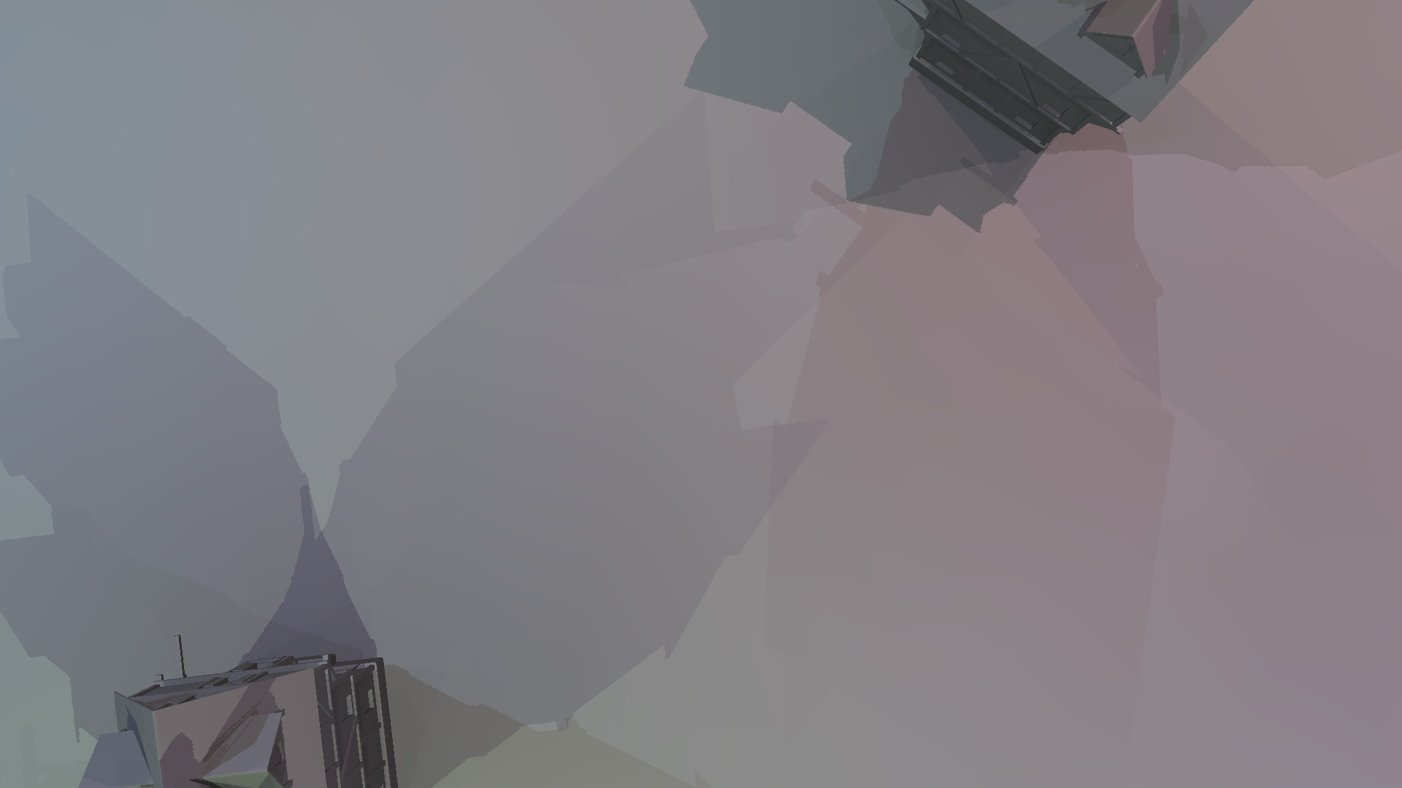
Shadow Quality
Notes:
Here is another screen shot from a scene in our paper with an average of 13 lights per pixel.
Despite this fairly high number each shadow is quite distinct, and so we need a non-approximate solution (which isn’t to say a non-aliased).

Slide 10
Fully Dynamic Scenes

Slide 11
Why Shadow Maps? (Oh why?)
De-facto standard
  Despite everything…
Shadows have high coherency.
Increased flexibility in HW/APIs.
Scaling no worse than other techniques.
Cube shadow maps available
Ray tracing / Shadow volumes / Etc?
  Not dynamic.
  Too slow.
  Unfilterable.
Notes:
Aiming for real time pretty much necessitates the use of shadow maps for the bulk of the work.
We will consider mostly omnidirectional lights and thus cube shadow maps.
Other light types are typically simpler and can be viewed as a special case.
As other solutions fail to deliver this level of performance.

Slide 12
Solution breakdown
Which lights cast shadows?
Required resolution for each shadow map?
Manage shadow map memory.
Cull shadow-casting geometry.
Draw shadow maps.
Shade scene.
Notes:
These are the steps we need to perform each frame, using the current camera view, to calculate a shaded scene.

Slide 13
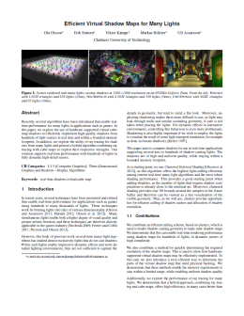
Shadows for many lights
Paper from I3D 2014 + TVCG 2015
  “(More) Efficient Virtual Shadow Maps for Many Lights”.
Builds on Clustered Shading
Adds support for shadows
  Hundreds in, real-time
    Well, research-real-time at least.
  High & Consistent quality
  Efficient culling
  Virtual/Sparse texture use case
Notes:
We will now talk about the techniques presented in my paper at I3D in 2014, with an extended version in TVCG - out now -
…titled More Efficient Virtual Shadow Maps for Many Lights.
This paper in turn builds on clustered shading,
and adds support for shadows from hundreds of lights in real time.
Since this paper provides efficient solutions to all the steps, it is a good starting point for this talk.

Slide 14
Solution breakdown
Which lights cast shadows?
Required resolution for each shadow map?
Manage shadow map memory.
Cull shadow-casting geometry.
Draw shadow maps.
Shade scene.
Notes:
The first step is the same as determining what lights are needed for shading
And we have already seen how this can be achieved using clustered shading and other methods.

Slide 15
Clustered Shading Key Features
Geometry
Clusters
  Proxy for visible geometry
    Bounds view samples
      3D boxes
    Orders of magnitudes
    fewer
  Cluster/Light Pairs
    Links clusters and lights
Occupied Cluster
C₀
Y
L₀
C₁
-Z
Eye
L₁
C₂
Near
C₃
Cluster/Light Pairs:
Far
C₁
L₀
C₂
L₀
C₂
L₁
C₃
L₁
…
Notes:
Note that the clustered shading method we build upon here is the one described in the paper, not Emils eminently practical method.
The reason for this is that we need some information about the shadow receiving geometry to be able to get good shadow performance.
Therefore, we cannot just use the up-front full grid approach.
Two things about clusters are worth repeating in this context:
First, the visible geometry is approximated reasonably well by the clusters, but there are very few in comparison. Usually around a thousand times more pixels than clusters, though this is of course tuneable with cluster size.
Secondly, clustered shading provides an association between clusters and lights. For shading it allows us to know which lights
affect each cluster, but also the reverse mapping, which we will make heavy use of to compute shadows.

Slide 16
Clustered Shading Key Features
Geometry
Clusters
  Proxy for visible geometry
    Bounds view samples
      3D boxes
    Orders of magnitudes
    fewer
  Cluster/Light Pairs
    Links clusters and lights
Occupied Cluster
C₀
Y
L₀
C₁
-Z
Eye
L₁
C₂
Near
C₃
Cluster/Light Pairs:
Far
C₁
L₀
C₂
L₀
C₂
L₁
C₃
L₁
…
Notes:
The key data is the cluster/light pairs that enable parallel operations on these pairs.
We use this for a lot of the processing later on.
In the illustration, the pair of integers link the L0 light and the C1 cluster, the cluster is shown here as containing geometry, and overlapping a light, and it is these that we will process.

Slide 17
Solution breakdown
Which lights cast shadows?
Required resolution for each shadow map?
Manage shadow map memory.
Cull shadow-casting geometry.
Draw shadow maps.
Shade scene.
Notes:
So, the clustered shading algorithm provides the lights affecting each cluster, and a light that does not affect any cluster need not be processed further.

Slide 18
Solution breakdown
Which lights cast shadows?
Required resolution for each shadow map?
Manage shadow map memory.
Cull shadow-casting geometry.
Draw shadow maps.
Shade scene.
Notes:
Next we must work out the resolution of each shadow map

Slide 19
Shadow Map Resolution
Pick constant resolution
  Under and Oversampling
  Poor quality
Notes:
We could of course just pick a constant resolution…
but then we’d not be talking about high quality shadows any more, with over and undersampling both being the norm.
Using oversampled shadow maps is not just wasteful in terms of memory, it is also slow and may yield aliasing.

Slide 20
Shadow Map Resolution
Pick constant resolution
  Under and Oversampling
  Poor quality
Match sample density
  Screen space
  Shadow-map space
Notes:
So what is a good resolution for a shadow map?
Well, the easiest way to think about it is that to avoid sampling artifacts (as far as possible)
Is to have one sample in the shadow map for each sample on screen…

Slide 21
Shadow Map Resolution
Match sample density
  Screen space
  Shadow map space
Screen Space Light projection [11]
  Over estimates.
Per-object resolution calc. [6]
  Influenced by object size.
Resolution Matched Shadow Maps [10]
  Accurate, but expensive.
Notes:
This has of course been explored before,
One common approach is to simply estimate the required resolution of the shadow map from the projection of the light bounding sphere.
This works well enough when the light is far away, and thus small on-screen.
But produces completely useless results when the camera is near or within the light sphere.
Another approach, is that of Forsyth, calculating the required resolution from the projection of each object that is to be drawn into the shadow map.
This suffers from problems similar to those of traditional forward shading,
where large objects causes problems.
In Resolution Matched Shadow Maps, the shadow map space derivatives is calculated for all samples in a full-screen pass.
This is obviously pretty accurate, but quite expensive, especially for many lights.
we’ll take this idea and apply the knowledge about clusters of view space samples available in clustered shading.

Slide 22
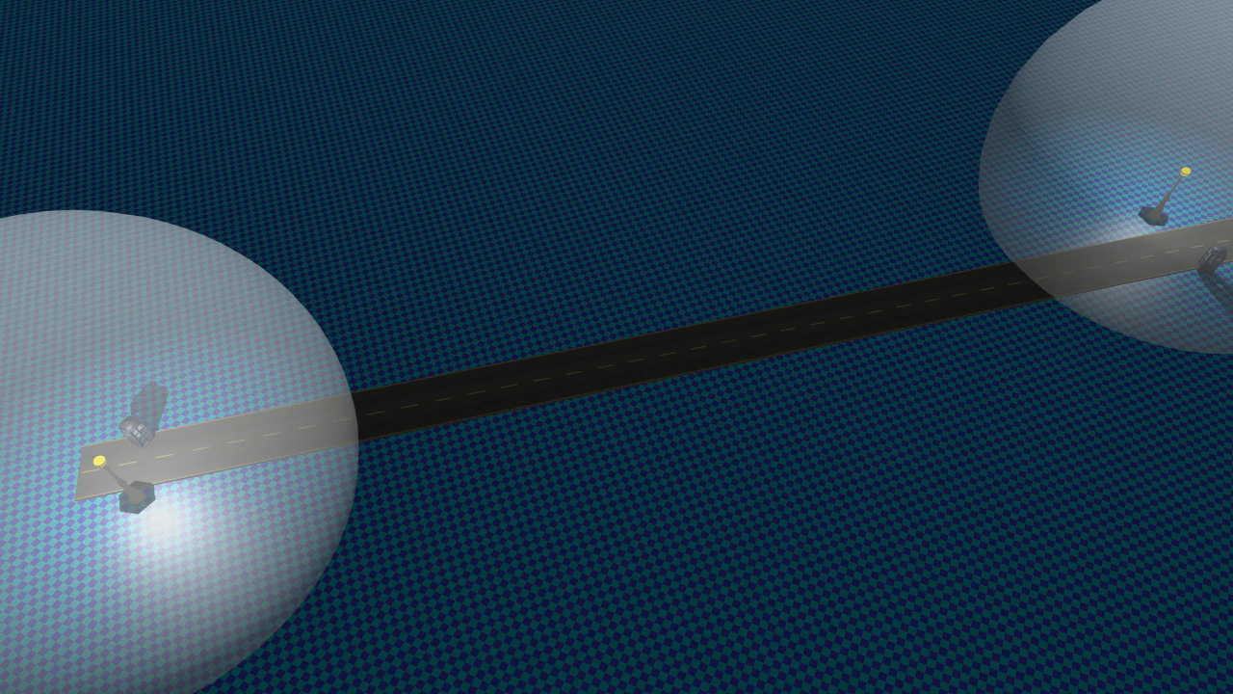
2. Shadow map resolution

Slide 23
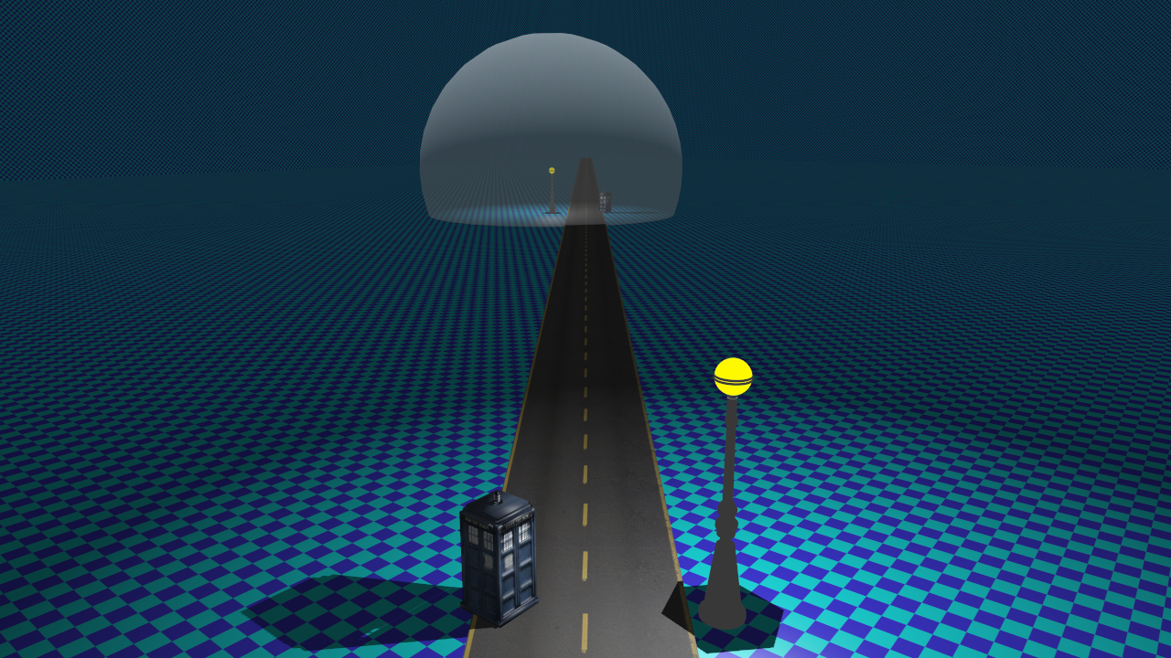
Shadow map res
Screen space bounding box:
~300² pixels
Notes:
One common approach is to simply estimate the required resolution of the shadow map from the projection of the light bounding sphere.
This works well enough when the light is far away, and thus small on-screen. <click>

Slide 24
Shadow map res
Screen space bounding box?
Notes:
But produces fairly useless results when the camera is near or within the light sphere.
Other approaches have been proposed that use shadow receiver locations to work out better estimates [Forsyth04,Lefohn07]
From clustered shading, we have a nice and coarse representation of the shadow receivers…

Slide 25
Shadow map res
Receiving object bounding box projection.
Notes:
Other approaches have been proposed that use shadow receiver locations to work out better estimates
For example projecting shadow receiver bounding boxes onto the light. [Forsyth04]

Slide 26
Shadow map res
Project individual samples.
Notes:
Or individual samples [Lefohn07]
This produces good results, but is expensive as there are many samples.
We therefore turn to…

Slide 27
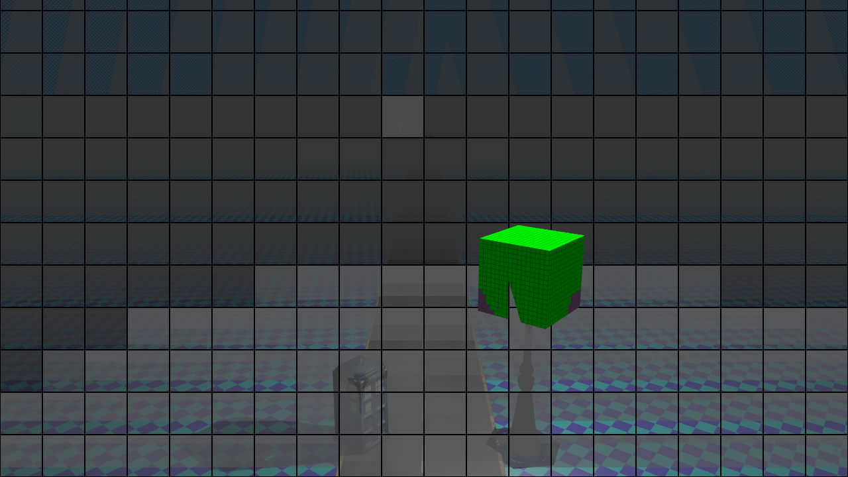
Shadow map res
Notes:
You said it: the clusters

Slide 28
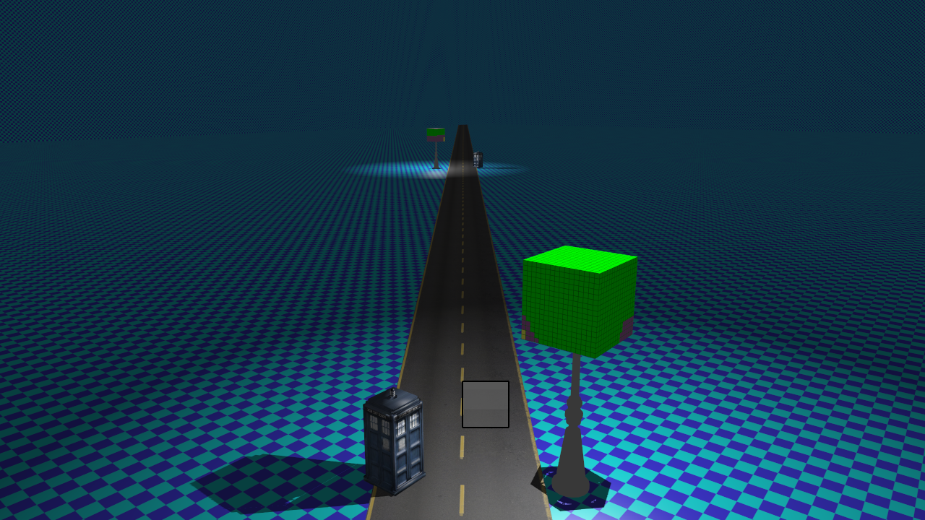
Shadow map res
Screen space cluster foot print:
64² pixels
Notes:
Each cluster has a fixed screen space footprint <click>

Slide 29
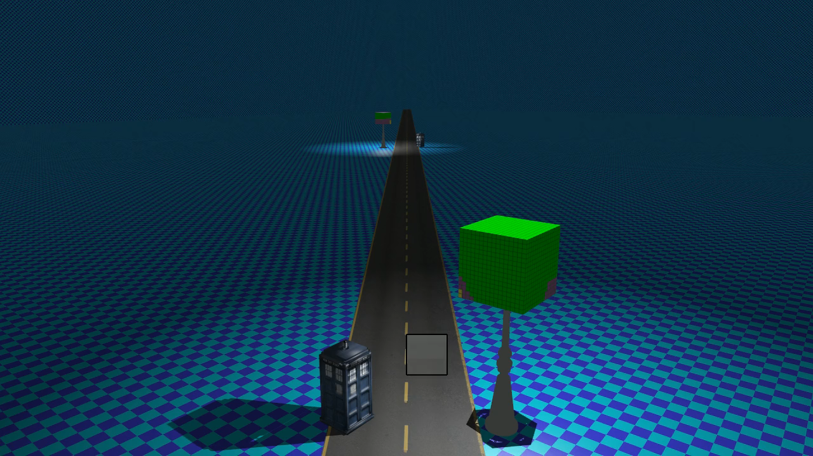
Shadow map res
Notes:
Seen from the side…

Slide 30
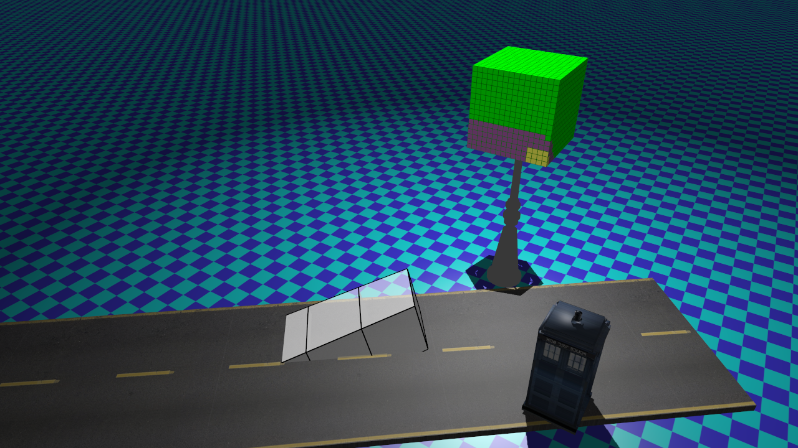
Shadow map res
Screen space cluster foot print:
64² pixels
Notes:
We see that the cluster, which by design is cubish in shape

Slide 31
Shadow map res
Shadow map cluster foot print:
64² texels
Screen space cluster foot print:
64² pixels
Notes:
Has a footprint on the shadow map

Slide 32

Shadow map res
Shadow map cluster foot print:
64² texels
Solid angle, $α$
Screen space cluster foot print:
64² pixels
Notes:
…which allows us to compute the required resolution as proportional to the solid angle
As usual the devil is in the paper, I mean the details!

Slide 33
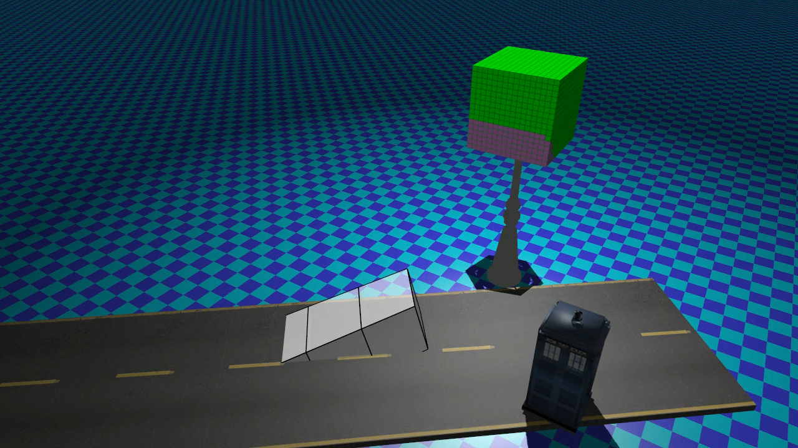
Shadow map res
Notes:
Going back…

Slide 34
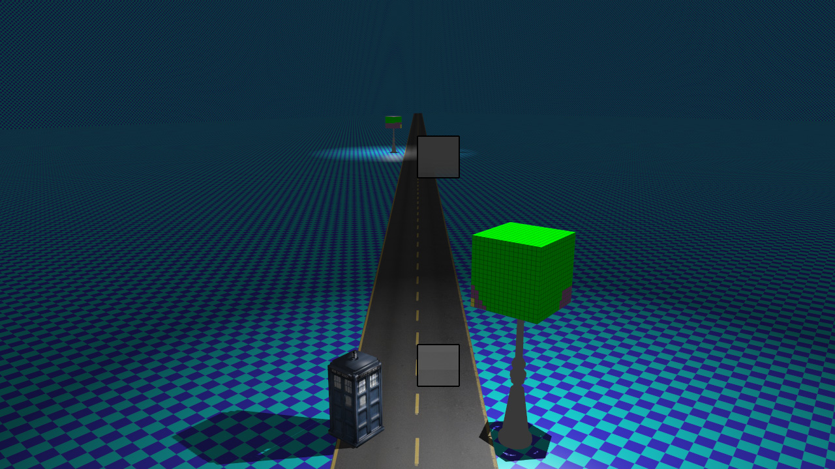
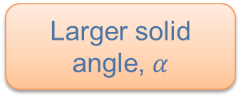
Shadow map res
Lower required resolution for SM
Same screen-space cluster foot print:
64² pixels
Larger solid angle, $α$
Notes:
We see that for a more distant shadow map, (or clusters closer to the SM)
The clusters subtend a larger solid angle, and thus the shadow map resolution becomes smaller.

Slide 35

Res calc.
Solid angle over light sphere
All cluster/light pairs in parallel
  Keep highest for each light
    atomicMax
$Res=\sqrt{\frac{S/(α/{4π})}{6}}$
  $α$= solid angle
  $S$ = Screen space foot print (e.g., 32x32)
Cluster
α
Light Source
Notes:
We perform this calculation in parallel for all cluster light pairs.
And reduce the final result for each light using atomic operations.

Slide 36
Solution breakdown
Which lights cast shadows?
Required resolution for each shadow map?
Manage shadow map memory.
Cull shadow-casting geometry.
Draw shadow maps.
Shade scene.
Notes:
This results in a list with a resolution for each light, or shadow map.
Some will have zero, if they are not referenced by any cluster/light pairs, and need not be considered further.

Slide 37
Solution breakdown
Which lights cast shadows?
Required resolution for each shadow map?
Manage shadow map memory.
Cull shadow-casting geometry.
Draw shadow maps.
Shade scene.
Notes:
Now, we’ll need to provide some shadow maps to match said resolutions.

Slide 38
Shadow Map Storage
Shadow maps required up front.
  Efficient storage paramount.
  Ideally: Store no unused samples!
    Somewhat tricky in practice.
    (Shadow Volumes , Ray tracing, Alias-Free Shadow Maps)
Notes:
Recall that clustered shading, like other modern modern real-time shading algorithms,
have the inner loop, in the fragment shader, iterates over a list of lights.
This means all shadow maps must exist up-front before the shading pass.
Consequently, efficiently managing shadow map storage has become a very important problem.
And this does not just mean parceling out shadow maps as needed,…
but ideally we should be able to store only those samples that matter.
Several shadow algorithms do just that, but fail to achieve consistent real-time performance,
For different reasons.

Slide 39
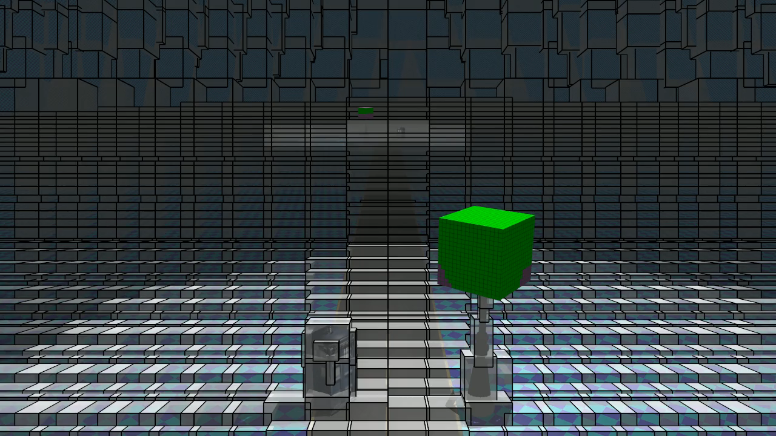
Shadow map storage
Notes:
Lets have a look again at the clusters…

Slide 40
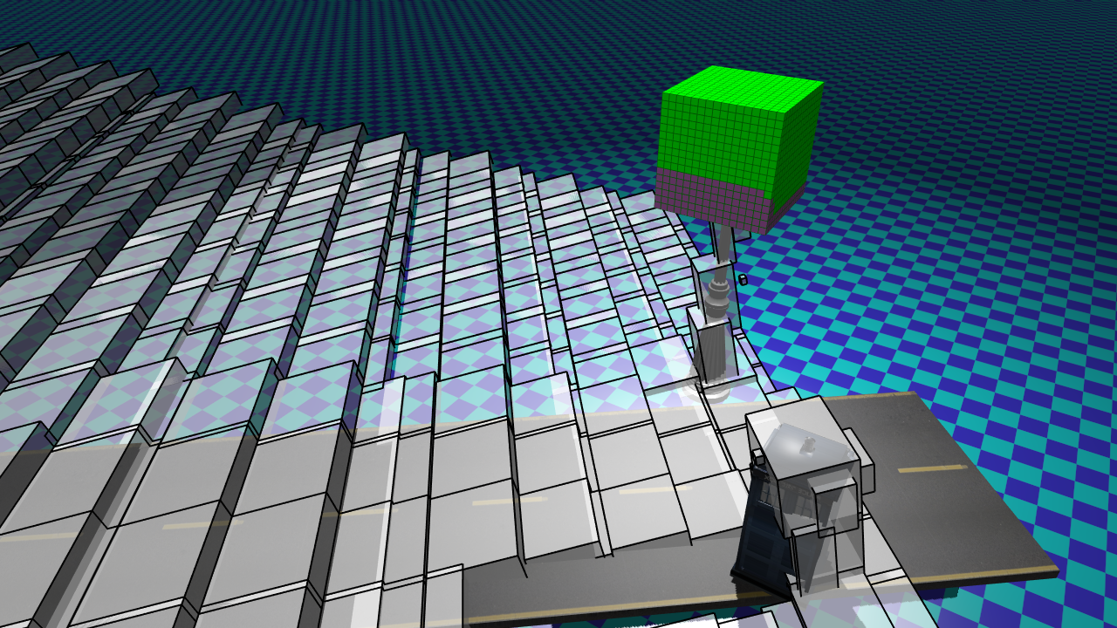
Shadow map storage
Notes:
showing their projection on the shadow map.

Slide 41
Shadow map storage
Unused!
Non-square region.
Notes:
Note how a large, and irregular area is unused.
Anything drawn into this part of the shadow map will not produce any visible shadow.
Clearly we should avoid allocating memory for this region, but how?

Slide 42
Shadow Map Storage
Fixed resolution
  Poor quality and/or utilization
Shadow map atlas
  Whole SM only, limited resolution
Split SMs + Atlas
  Seams, overlap, costly culling
Software virtual shadow maps
  Costly and complex
Notes:
Reviewing typical options we could:
Our solution is to use…

Slide 43
Hardware Virtual Textures*
1024 x 1024 Texels
Allocate Virtual Texture Storage
  Just like virtual memory.
  Low overhead.
Physical backing in Tiles (Pages)
  E.g., 256 x 256 Texels.
Recent APIs.
  OpenGL 4.4 extension [4]
    ARB_sparse_texture
  DirectX 11.2
    Tiled Resources [5]
  Vulkan? DX12? Consoles? (GCN)
Tile
256 x 256
Not
used
* Or: Sparse Textures, Partially Resident Textures
Notes:
Our answer is hardware supported virtual, or sparse, textures…
These have become available in mainstream graphics APIs recently,
and makes it possible to allocate large virtual textures,
…but commit physical storage in tiles only where needed.
This fits our ideal pretty well, especially given that shadow map samples tend to clump together because of screen-space coherency [10].

Slide 44
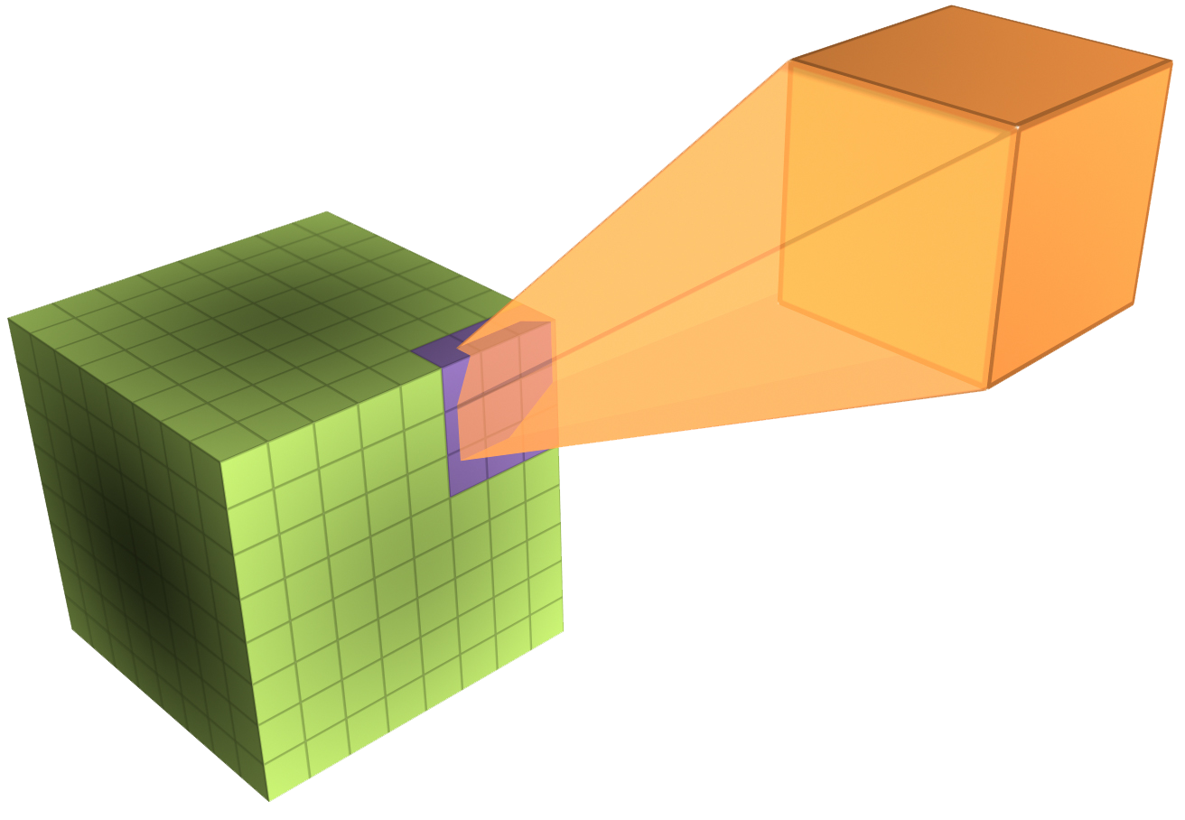
Determining Used Pages
Project Clusters onto shadow maps
  Cluster’s world space AABB.
  Shadow map in world space.
  Simple calculation.
Cluster AABB
Shadow Map
Notes:
This requires project bounding boxes onto the cube maps, which is not trivial
By transforming the cluster AABB to world space,
and also keeping cube shadow maps in world space.
Calculating the projection can become quite simple and fast.

Slide 45
Cube Face +X
float rdMin = 1.0f / max(Epsilon, aabb.min.x);
float rdMax = 1.0f / max(Epsilon, aabb.max.x);
float sMin = min(-aabb.max.z * rdMin, -aabb.max.z * rdMax);
float sMax = max(-aabb.min.z * rdMin, -aabb.min.z * rdMax);
float tMin = min(-aabb.max.y * rdMin, -aabb.max.y * rdMax);
float tMax = max(-aabb.min.y * rdMin, -aabb.min.y * rdMax);
Bounding rectangle on cube face.
Repeat 6 times, slightly different.
Notes:
This code is what we use to compute the projection on one cube face.
And as you can see, it is not extremely complex.
We repeat this, slightly differently for each face and get a rectangle in texture coordinates for each.
This is then converted to a bit mask, with a single bit for each tile or page in the virtual cube map.
This very quick bit-grid rasterization is something we build most of the efficiency improvements in our algorithm on.

Slide 46
Process
In parallel, for each cluster/light pair
  Project cluster AABB onto light SM.
  Update bit masks for each light.
    One bit/physical page.
    32x32x6 bits = 768 byte / light.
  Atomic reduction atomicOr
  <0.25ms / 180k cluster/light pairs
Cluster AABB
Shadow Map
Notes:
We compute this mask, by running a cuda thread for each cluster/light pair.
In the kernel we calculate the projection just shown
As the mask is stored for each light and thus referenced by many cluster light pairs,
It is updated using atomicOr.
This is a pretty quick pass, <0.25ms, 180k light/cluster pairs.

Slide 47
Process
In parallel, for each cluster/light pair
  Project cluster AABB onto light SM.
  Update bit masks for each light.
    One bit/physical page.
    32x32x6 bits = 768 byte / light.
  Atomic reduction atomicOr
  <0.25ms / 180k cluster/light pairs
Copy masks back to host.
Commit physical pages (host)
  glTexPageCommitmentARB
Cluster AABB
Shadow Map
Notes:
The masks are copied back to the host, and used to commit pages for the shadow map textures.
And here we really could use an indirect API to avoid nasty stalls!

Slide 48
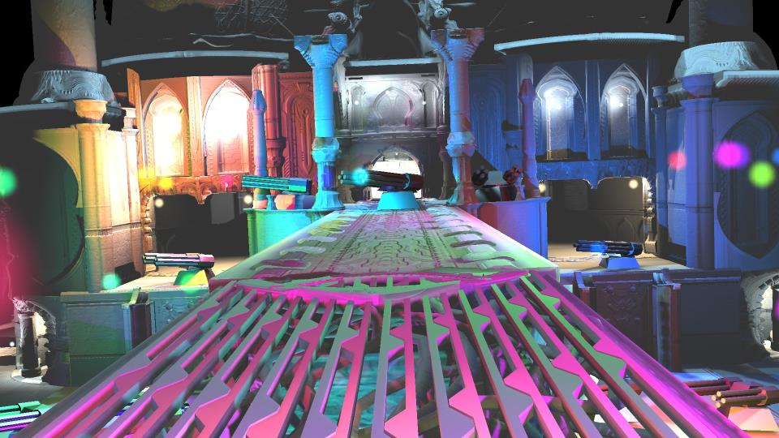
Virtual SMs – Results
Necropolis, Peak Shadow Map Usage
Standard | Virtual | Difference
4.2G Texels | 161M Texels | 26 X
Notes:
So we might ask, is it worthwhile doing virtual shadow maps?
Well, for the necropolis scene, there is a factor 26 improvement, compared to physical shadow maps of the same quality
And <click>

Slide 49
Virtual SMs – Results
Necropolis, Peak Shadow Map Usage
Standard | Virtual | Difference
4.2G Texels | 161M Texels | 26 X
8.4G Byte | 322M Byte | Doable!
Notes:
…in other terms, this means the difference between impossible on a current console
And something we might consider.

Slide 50
Quality vs. Memory Usage
Quite uniform quality.
Simple to reduce
  Undersampling parameter.
Control memory use.
Could be done dynamically.
  Guarantee peak memory use?
Notes:
Our method achieves quite uniform shadow quality,
This means we can control quality and thus memory usage with a global parameter.
This allows more flexibility in memory use while maintaining uniform quality.
Rather than say, some lights getting very poor shadows and others good.
One idea is to do this dynamically, to ensure a certain memory budget.
Should be possible as it is very quick to work out memory usage from the used pages and resolutions.

Slide 51
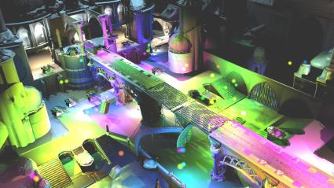

Quality vs. Memory Usage
2x Undersampling ~140Mb
4x Undersampling ~80Mb
Notes:
Here is a shot showing this, with 2x or 4x global reduction in shadow map resolution.
Shown are the corresponding peaks in shadow map memory usage.
Recall that the peak is 322MB without reducing quality.

Slide 52
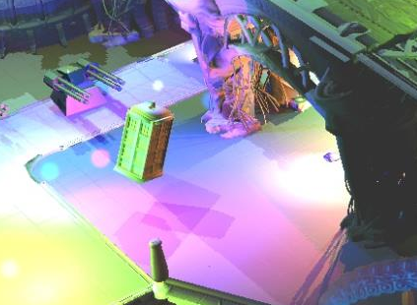

Quality vs. Memory Usage
2x Undersampling ~140Mb
4x Undersampling ~80Mb
Shadow Aliasing
Shadow Aliasing
Edge Aliasing
Edge Aliasing
Notes:
Zooming in, we see that the shadow aliasing is about the expected level when compared to edge aliasing in the image.
This indicates that our simple scheme for calculating the required resolution yields reasonable results.
With filtering, this can be acceptable, especially as it allows uniform quality rather than unevenly allocating shadow maps.
Memory usage is, reduced significantly.

Slide 53
Solution breakdown
Which lights cast shadows?
Required resolution for each shadow map?
Manage shadow map memory.
Cull shadow-casting geometry.
Draw shadow maps.
Shade scene.
Notes:
So that takes care of memory management, and we can now allocate shadow maps to draw into.

Slide 54
Solution breakdown
Which lights cast shadows?
Required resolution for each shadow map?
Manage shadow map memory.
Cull shadow-casting geometry.
Draw shadow maps.
Shade scene.
Notes:
Next must rasterize triangles into the shadow maps.
To do this efficiently requires culling, as with any rasterization, only more so.

Slide 55

Basic Culling
Just like View Frustum Culling
  Cull chunks of geometry.
  Using bounding boxes.
Eye/Camera (Light)
Notes:
This process is just like good old view frustum culling
In that we are trying to get rid of geometry that is not visible, or within the view-volume.
And that we do this by testing bounding volumes representing batches of triangles.

Slide 56
Basic Culling
Not like VFC
  Hundreds of lights.
  Mostly short view volumes.
    Limited light range.
  Omni-directional lights.
    6 adjacent frustra.
    Sharing planes.
Cube Culling
Planes
Light Sphere
Notes:
What is not like view frustum culling is that we need to perform hundreds of these tests.
The view volumes are quite small, or short, given the limited range of the lights
There are 6 adjacent frustra sharing planes.
And this adjacency is an opportunity to share calculations.

Slide 57
Basic Culling
int getCubeFaceMask(float3 cubeMapPos, Aabb aabb)
{
float3 planeNormals[] = { {-1,1,0}, {1,1,0}, {1,0,1}, {1,0,-1}, {0,1,1}, {0,-1,1}};
float3 absPlaneNormals[] = { {1,1,0}, {1,1,0},{1,0,1}, {1, 0,1}, {0,1,1}, {0,1,1}};
float3 center = aabb.getCentre() - cubeMapPos;
float3 extents = aabb.getHalfSize();
bool rp[6];
bool rn[6];
for (int i = 0; i < 6; ++i)
{
float dist = dot3(center, planeNormals[i]);
float radius = dot3(extents, absPlaneNormals[i]);
rp[i] = dist > -radius;
rn[i] = dist < radius;
}
int fpx = rn[0] && rp[1] && rp[2] && rp[3] && aabb.max.x > cubeMapPos.x;
//…same for other faces…
return fpx | (fnx << 1) | (fpy << 2) | (fny << 3) | (fpz << 4) | (fnz << 5);
}
Literal constants, all ones or zeroes.
If unrolled, very few operations left!
Notes:
Here is the somewhat condensed code we use to calculates the culling mask, with a bit for each cube face.
This a very efficient, testing only 6 planes for six frustums. (click)
Especially as the plane equations are all ones and zeroes, (click)
Which means that if the loop is unrolled, most of this code just goes away!
I think this is a rather big advantage with cube maps, over using separate frustums (As done in [6]).
This efficiency is especially important given that we will be culling a lot more objects than normal culling!
How so, I hear you say?
Glad you asked!

Slide 58
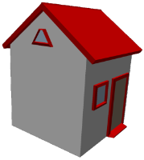
Basic Culling
Fine Granularity (Batches)
  Must be small.
  Match size of light.
Notes:
You see, to enable effective culling, as in getting rid of a large proportion of the triangles, batches must be small,
Intuitively, for any culling operation, the optimal size of batches correlates to the size of the frustums.

Slide 59
Basic Culling
Fine Granularity (Batches)
  Must be small.
  Match size of light.
1000 Tris x 3 Cube faces
= 3k
Notes:
If batches are too large, the triangles get replicated into most cube faces replicated.

Slide 60
Basic Culling
Fine Granularity (Batches)
  Must be small.
  Match size of light.
1000 Tris x 3 Cube faces
= 3k
Notes:
Smaller batches, enables

Slide 61
Basic Culling
Fine Granularity (Batches)
  Must be small.
  Match size of light.
(250 Tris x 2) x 2
= 1k
1000 Tris x 3 Cube faces
= 3k
Notes:
More precise culling, and thus fewer triangles drawn.
So we are trading increased culling work for fewer triangles drawn.
Triangle drawing is the biggest performance bottleneck so this is important to be able to tune.

Slide 62
Batches
Batch ~ 100 triangles
  AABB.
  Index to transform, triangles.
Constructed offline
  Group Coherent Triangles.
    Same transform(s).
  Flat array.
struct Batch
{
Aabb aabb;
int tris;
int offset;
int transformInd;
};
Notes:
We used batches around 100 triangles,
A batch is represented by an AABB and a list of triangles and they are constructed in a pre-process.
The batches are stored in a flat array that is loaded into the runtime.

Slide 63
Batch BVH
Constructed online
  Each frame.
  Batch AABBs updated from
  vertices.
  Simple 32-way full BVH.
Traverse in parallel for each light
1
2
3
4
Notes:
At run-time the batch bounds are updated and a simple BVH is constructed on the GPU
This is then traversed for each light to build a list of batches for each shadow map.

Slide 64
Better Culling
Unused!
Non-square region.
Notes:
Recall the projection of the clusters on the shadow map.
And how a large, and irregular area is unused.
Apart from storing this region, it is also a bit silly to draw anything into it!

Slide 65
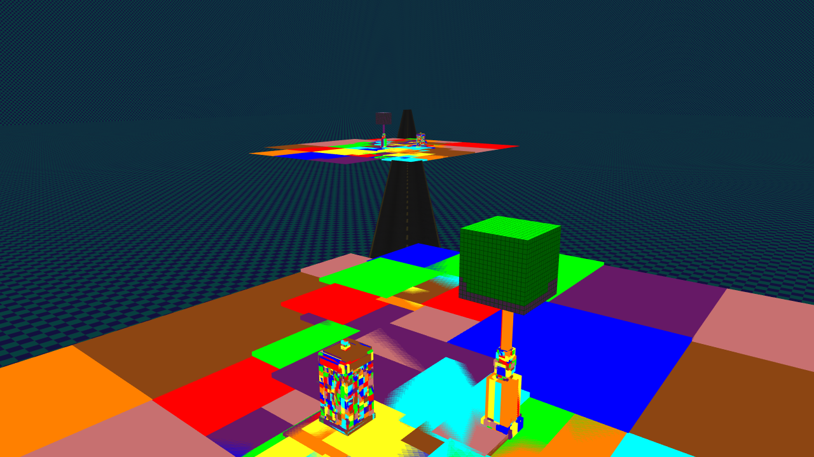
Better Culling

Slide 66
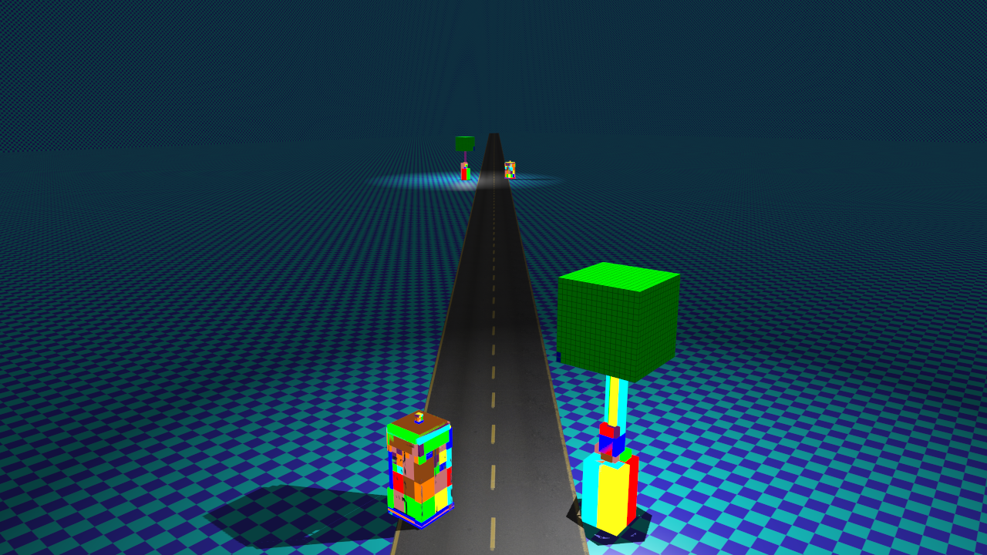
Better Culling

Slide 67
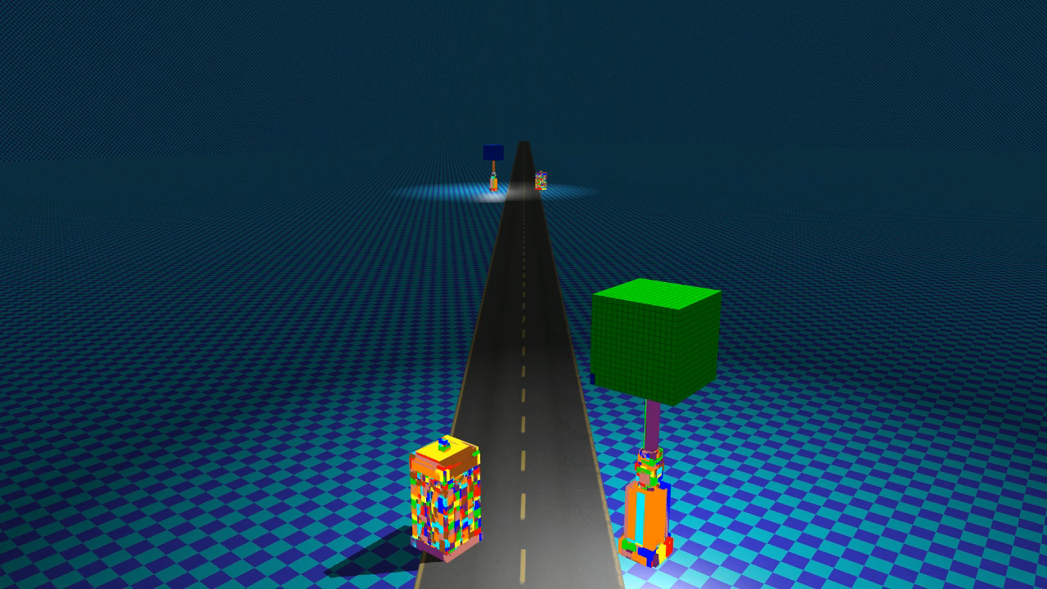
Better Culling

Slide 68
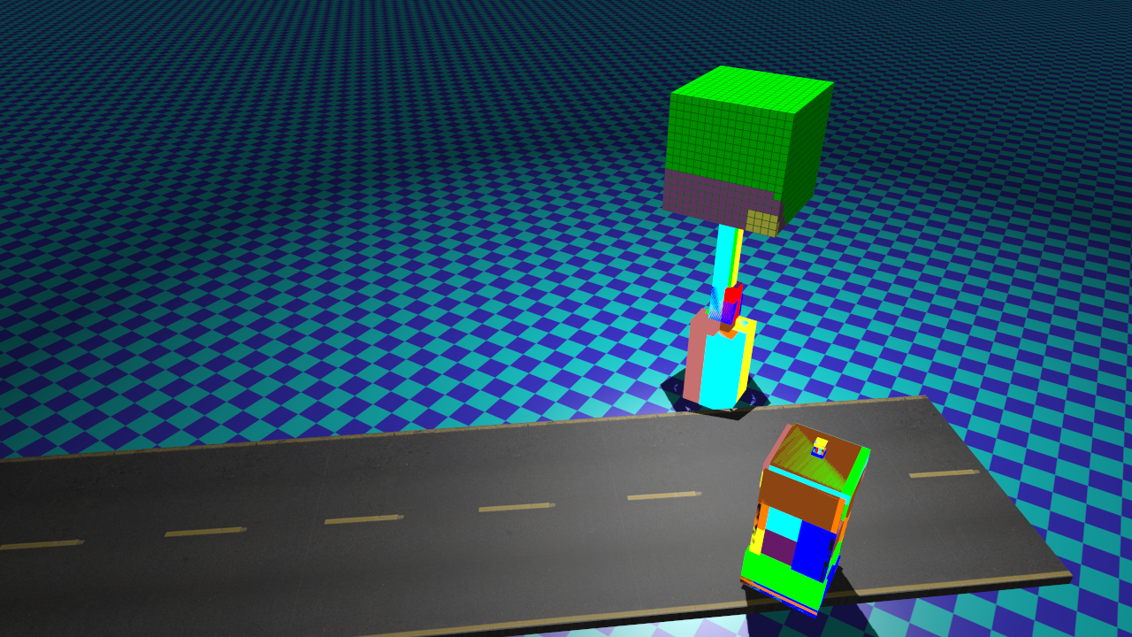
Better Culling

Slide 69
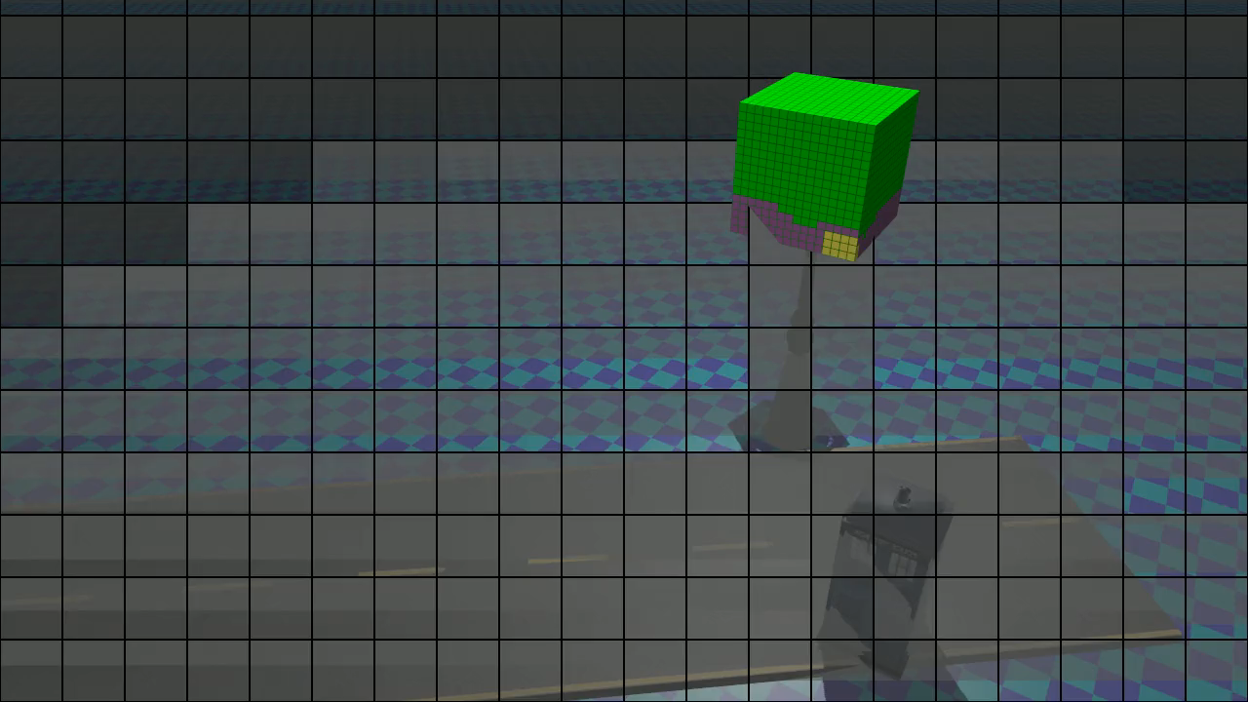
Better Culling

Slide 70
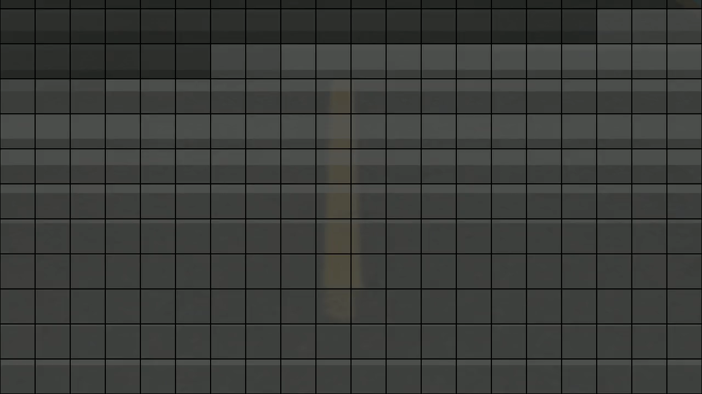
Better Culling

Slide 71
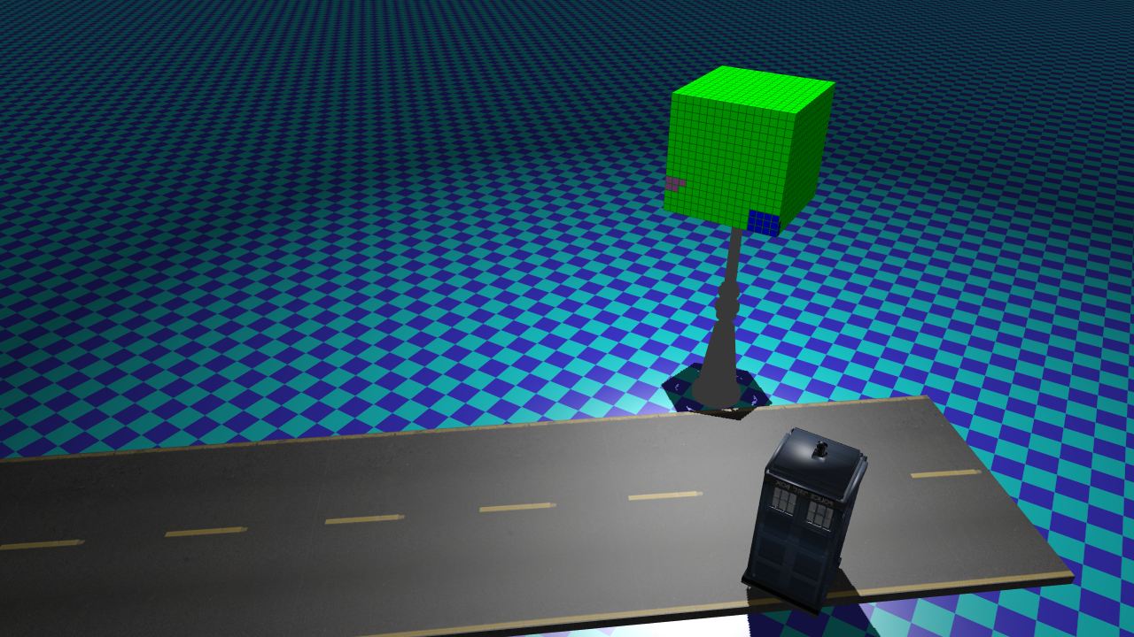
Better Culling
Projection of Clusters
No overlap.
Discard batches
Projection of Batches

Slide 72
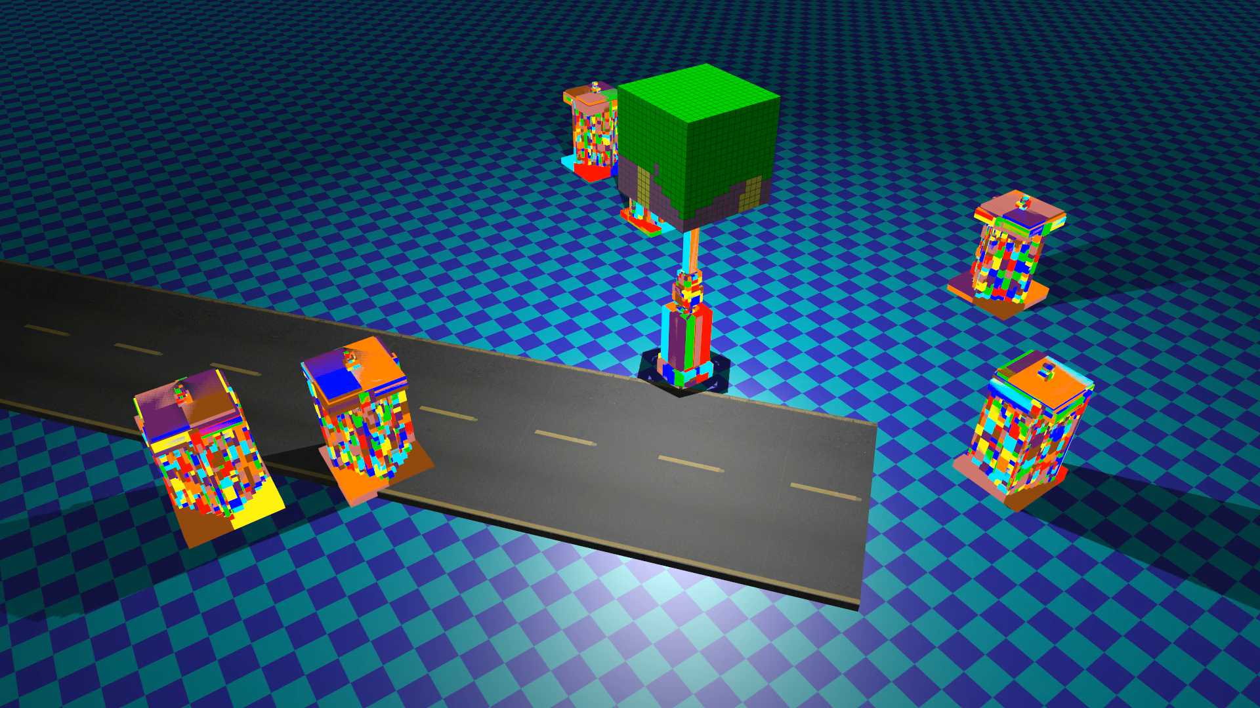

Slide 73
Prune Batches
Calculate projection maps for lights.
Loop over result of basic culling
  Compute batch mask.
  Compare to projection map.
    Bitwise AND
  Discard if no overlap
Notes:
We implement this with a pass over all the results from the previous step.
The kernel just loads the light and cluster, and computes the projection for the cluster
For any face where there is no overlap, the cube face mask bit is cleared, meaning it will not be drawn.
Finally the updated CFMs are stored back, now usually with fewer bits set, and sometimes zero.

Slide 74
Solution breakdown
Which lights cast shadows?
Required resolution for each shadow map?
Manage shadow map memory.
Cull shadow-casting geometry.
Draw shadow maps.
Shade scene.

Slide 75
Solution breakdown
Which lights cast shadows?
Required resolution for each shadow map?
Manage shadow map memory.
Cull shadow-casting geometry.
Draw shadow maps.
Shade scene.

Slide 76
Drawing
Culling on GPU.
Builds draw commands.
  GPU buffer.
One draw call / light
  glMultiDrawElementsIndirect(…);
Notes:
As all the culling is performed on the GPU, using CUDA, make use of modern OpenGL and build draw commands also on the GPU
Then we just call multi draw indirect once for each cube map, though it could be done once for all in principle.

Slide 77
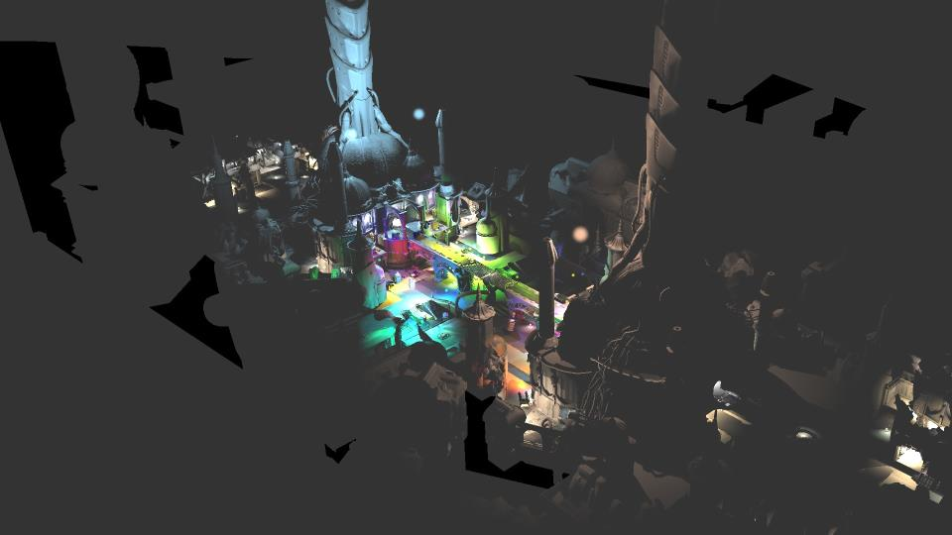
Results
Peak ~250k batches.
Necropolis, Peak Triangles/Frame
Naïve (x6) | CFM | Projection Map | Difference
126 M | 20 M | 13 M | ~10x
Notes:
At the peak, we draw around 250 thousand batches into the shadow maps, with instancing on top.
Using the culling techniques just outlined, this results in some 13 million triangles
which is almost 10 times better than the naïve approach of replicating the triangles to all cube faces.
And some 65% of performing culling just using the cube face mask.
The cube face mask path actually already detects completely empty cube faces, and so is already quite effective.

Slide 78
Results
Peak ~250k batches.
Necropolis, Peak Triangles/Frame
Necropolis, Peak Triangles/Frame
Naïve (x6) | CFM | Projection Map | Difference
126 M | 20 M | 13 M | ~10x
~150 ms? | 25 ms | 16 ms | Doable!
Notes:
Again, put differently, this is the difference between infeasible and something we can do in real time.

Slide 79
Results
Optimization Note:
Achieved triangle rate: ~800M Tris/s
GeForce Titan peak:
~4.2G Tris/s
Difference: ~5x
Peak ~250k batches.
Necropolis, Peak Triangles/Frame
Naïve (x6) | CFM | Projection Map | Difference
126 M | 20 M | 13 M | ~10x
~150 ms? | 25 ms | 16 ms | Doable!
Notes:
As a side note, our implementation achieved a fifth of the theoretical peak triangle rate
So there could be some pretty good improvements for the handy optimizer out there.

Slide 80
Solution breakdown
Which lights cast shadows?
Required resolution for each shadow map?
Manage shadow map memory.
Cull shadow-casting geometry.
Draw shadow maps.
Shade scene.
Notes:
We now have all the components needed to shade the scene.

Slide 81
Solution breakdown
Which lights cast shadows?
Required resolution for each shadow map?
Manage shadow map memory.
Cull shadow-casting geometry.
Draw shadow maps.
Shade scene.

Slide 82
Shading (2015 edition)
Loop over lights
  Light index ⬄ shadow map index
Calculate cube face index from direction
  GCN: cubeFaceIndexAMD[4].
Calculate cube face coords. from direction
Sample 2D layer in shadow map
Note:
  Not using bindless textures (contrary to I3D paper)!
  Reason:
    Conformant to ARB Spec.
    2X performance increase in shading (NVIDIA HW).
Notes:
So shading the image is simple
The light index is just used to look up the shadow map
Which is stored in an array texture, and so on.
The reason we now use an array texture and not bindless textues (like last year) is that it is not actually conformant to the ARB spec, and is only supported on NVIDIA hardware.
But even there it is very slow.

Slide 83
Solution breakdown
Which lights cast shadows?
Required resolution for each shadow map?
Manage shadow map memory.
Cull shadow-casting geometry.
Draw shadow maps.
Shade scene.

Slide 84
Solution breakdown
Which lights cast shadows?
Required resolution for each shadow map?
Manage shadow map memory.
Cull shadow-casting geometry.
Draw shadow maps.
Shade scene.
Done!
Notes:
So we’re done… well almost.

Slide 85
Exploiting static Scene Elements

Slide 86
Static scene elements
Static lights & shadow casters
  Precompute shadows [Kämpe15]
    Voxelized shadows.
    High-quality filtering.
  Shadow Proxies [Valient14]
    Pre-compute static geometry for static lights.
    Render proxies + dynamic at run time.
Static shadow casters
  Ray tracing [Olsson14,Harada13]
  Signed distance fields?
Problem: What if shadow casters move, sometimes?

Slide 87
Extending our algorithm
Keep shadow maps
  Easy!
  All SMs allocated up front
Don’t re-draw unchanged portions
  Not quite as easy…
  But lets try!

Slide 88
Yet more efficient culling
Discard batch if:
  The light is static.
  The batch is static.
  The batch was drawn last frame.
  The batch does not overlap any dynamic batch drawn the previous frame.
  The batch projection does not overlap any virtual page that is committed this frame.
  The shadow-map resolution is unchanged.

Slide 89
New problems
Light/Batch static?
  Just flag them based on animation etc.
Batch drawn last frame?
  Flag? - Too many…
  Test previous frame’s projection map!
Overlaps dynamic?
  Record dynamic batches in new projection map.
Newly committed?
  Test against virtual page mask.
Clear ‘trace’ after dynamic batches
  Draw point sprites to clear.

Slide 90
Culling
Frame 0
Projection Map:
1
1
1
0
0
0
0
0
&
Batch Projection:
0
1
1
0
0
0
0
0
Eye/Camera
=
Intersection:
1
1
Notes:
To recap the logic for our improved culling, this time in 1D
We have the projection map of the light,
Then build the map for the batch and test against it

Slide 91
Frame 0
Projection Map:
1
1
1
0
0
0
0
0
&
Batch Projection:
0
1
1
0
0
0
0
0
Eye/Camera
=
Draw!
Intersection:
1
1
Notes:
When there is any intersection, we draw the batch.

Slide 92
Frame 0
Projection Map:
1
1
1
0
0
0
0
0
&
Batch Projection:
0
1
1
0
0
0
0
0
Eye/Camera
=
Intersection:
1
1
Frame 1
Prev Proj. Map:
1
1
1
0
0
0
0
0
&
Batch Projection:
0
1
1
0
0
0
0
0
=
Intersection:
1
1
Notes:
Now, the following frame, imagine nothing has changed.
We now make use of the projection map of the light from the previous frame.
This is tested against the batch projection, same as before, but!

Slide 93
Frame 0
Projection Map:
1
1
1
0
0
0
0
0
&
Batch Projection:
0
1
1
0
0
0
0
0
Eye/Camera
=
Intersection:
1
1
Frame 1
Prev Proj. Map:
1
1
1
0
0
0
0
0
&
Batch Projection:
0
1
1
0
0
0
0
0
=
Discard!
Intersection:
1
1
Notes:
If there is an overlap, we should discard the batch, because it must have been drawn last frame.
Recall both light and batch are static so neither could have moved.

Slide 94
Frame 0
Projection Map:
1
1
1
0
0
0
0
0
Batch Projection:
0
1
1
0
0
0
0
0
Intersection:
1
1
Eye/Camera
Dyn. Proj Map:
0
0
0
0
0
1
1
1
Notes:
Now lets make the second batch dynamic and moving left.
We build a dynamic batch projection map while culling, that records any dynamic batches drawn.

Slide 95
Frame 0
Projection Map:
1
1
1
0
0
0
0
0
Batch Projection:
0
1
1
0
0
0
0
0
Intersection:
1
1
Eye/Camera
Dyn. Proj Map:
0
0
0
0
0
1
1
1
Frame 1
Prev Dyn. Proj.
Map:
0
0
0
0
0
1
1
1
&
Batch Projection:
0
1
1
0
0
0
0
0
=
Intersection:
0
0
0
0
0
0
0
0
Dyn. Proj Map:
0
0
1
1
1
0
0
0
Notes:
The following frame we intersect this map with the batch projection map
There is no overlap so we can still discard the static batch.
But note how the dynamic batch actually now overlaps the static batch…
Which means that next frame, it must be re-drawn.

Slide 96
Frame 2
Prev Dyn. Proj.
Map:
0
0
1
1
1
0
0
0
&
Batch Projection:
0
1
1
0
0
0
0
0
Eye/Camera
=
Intersection:
0
0
1
0
0
0
0
0
Notes:
Which we discover by comparing the previous frame’s dynamic projection map.

Slide 97
Frame 2
Prev Dyn. Proj.
Map:
0
0
1
1
1
0
0
0
&
Batch Projection:
0
1
1
0
0
0
0
0
Eye/Camera
=
Draw!
Intersection:
0
0
1
0
0
0
0
0
Notes:
Which we discover by comparing the previous frame’s dynamic projection map.

Slide 98
Frame 2
Prev Dyn. Proj.
Map:
0
0
1
1
1
0
0
0
&
Batch Projection:
0
1
1
0
0
0
0
0
Eye/Camera
=
Draw!
Intersection:
0
0
1
0
0
0
0
0
Notes:
The dynamic projection map tells us what parts to clear and re-draw.
Page commits have the same effect, essentially, and are treated similarly.
This means that we can make minimal changes to the shadow maps with very little extra work and overhead.
So at one extreme, if nothing moves, nothing is drawn.

Slide 99
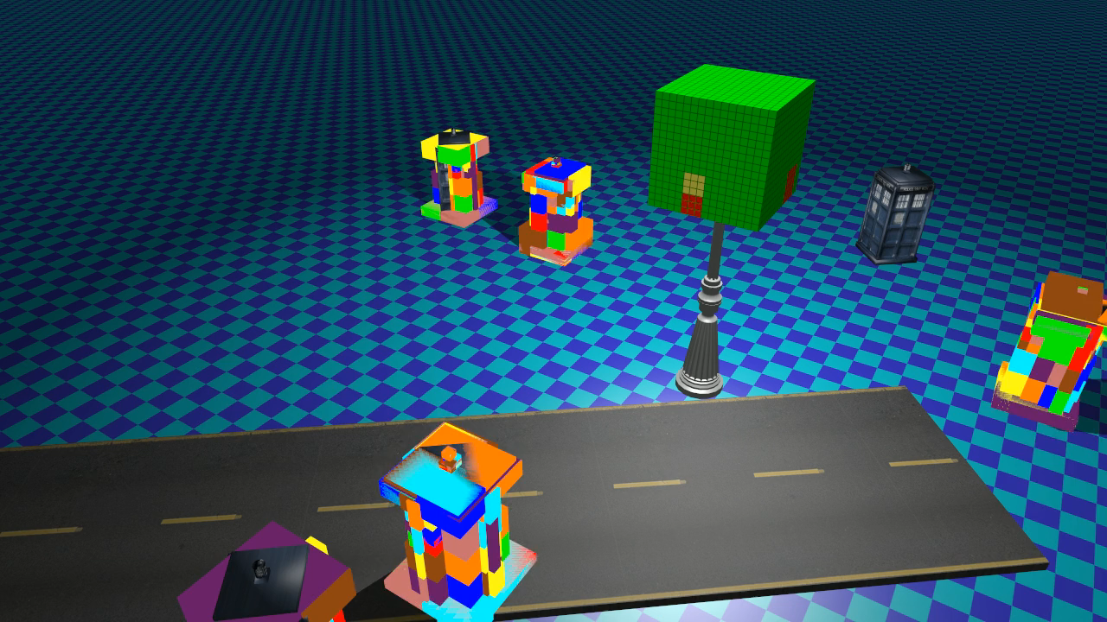
Animated Batches

Slide 100
Performance (Necropolis animation)
Normal
With Static Optimizations
Notes:
This plot shows how this works out for the heaviest scene in the extended paper, necropolis.
As you can see, the work is substantially reduced for most of the animation, although the peak is only moderately improved.
This is a scene where most of the lights in the central area are moving, so this is perhaps not surprising.

Slide 101
Future work
Our design too forgetful!
  Drops pages as soon as possible.
  Changes in resolution causes re-draw.
Instead
  Keep pages as long as possible
  Fixed size memory pool
    LRU policy for re-use?
  Keep resolution longer (if static)?
  Resample higher-res?
Notes:
Our design currently drops pages as soon as they are not used.
This means that we might drop a page only to need to re-render it very soon again.
If this memory is not needed elsewhere, we caused an unnecessary redraw.
This was not a problem before we started retaining static information,
but now a more conservative scheme, for example based on a LRU policy is probably better.
Or some other policy that avoids discarding a rendered page unless needed.
For static lights some quality might also be traded for keeping shadow maps around longer.
When a shadow map becomes lower res, we could even try resampling the higher res shadow map, to save further rendering.

Slide 102
Problem #1 – Slow commits
Page commits
  Up to ~2500 commits / frame
  Average: ~7 µs / commit.
    -> 17ms / frame
  Peak: ~40 µs / commit
    -> ~100ms / frame
  High variability.
Getting better
Need batch API
  Like DX11
Notes:
I have to bring a couple of issues to your attention.
The first, that page commits are slow, has gotten a lot better.
It used to be a couple of milliseconds per commit.
However, while it can be usable for real-time performance today, there is still a high variability in the cost.

Slide 103
Problem #2 – Clearing large array textures
Virtual storage
  2048 * 8K2 = 128G texels
Clear affects all layers
Workaround #1
  Texture views, clear 6 layers
  Still, very slow (NVIDIA HW)
    ~90ms / frame
Peak Physical: 161M texels
Workaround:
  Draw point sprite for each committed page.
  ~1ms / frame

Slide 104
Upbeat slide about clusters!

Slide 105
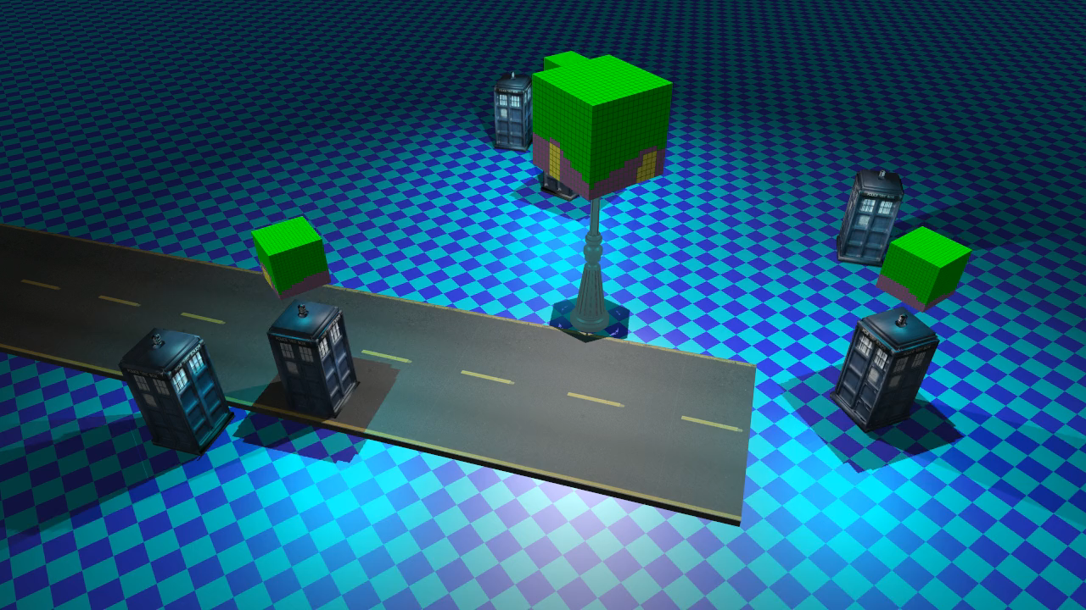
The End!

Slide 106
References
[Persson13] Practical Clustered Deferred and Forward Shading, Persson & Olsson 2013, http://advances.realtimerendering.com/s2013
[Olsson12a] Clustered Deferred and Forward Shading, Olsson et.al. 2012
[Olsson12b] Tiled and Clustered Forward Shading, Olsson et.al. 2012
[Valient14] Reflections and volumetrics of Killzone Shadow Fall , SIGGRAPH’14, http://advances.realtimerendering.com/s2014
[Andersson14] Rendering Battlefield 4 with Mantle, GDC 2014
[Shulz14] Moving to the Next Generation - The Rendering Technology of Ryse, GDC 2014.
[Tebbs92] Brice Tebbs, Ulrich Neumann, John Eyles, Greg Turk, and David Ellsworth. Parallel architectures and algorithms for real-time synthesis of high quality images using deferred shading. 1992.
[Saito90] Takafumi Saito and Tokiichiro Takahashi. Comprehensible rendering of 3-d shapes. SIGGRAPH Comput. Graph., 24(4):197–206, 1990.
[Hargreaves04] Shawn Hargreaves and Mark Harris. Deferred shading. NVIDIA Developer Conference: 6800 Leagues Under the Sea, 2004.
[Shishkovtsov05] Oles Shishkovtsov. Deferred shading in S.T.A.L.K.E.R. In GPU Gems 2. Addison-Wesley, 2005.
[Arvo03] Jukka Arvo and Timo Aila. Optimized shadow mapping using the stencil buffer. JGT, 8(3):23–32, 2003.
[Harada12] A 2.5D culling for forward+. In SIGGRAPH Asia 2012 Technical Briefs, ACM, 18:1–18:4.
[Lauritzen12] Andrew Lauritzen, Intersecting Lights with Pixels, In SIGGRAPH 2012 Courses, Beyond Programmable Shading,
[Ferrier11] Alex Ferrier and Christina Coffin, Deferred shading techniques using frostbite in "Battlefield 3" and "Need for Speed the Run“, SIGGRAPH 2011 Talks
[Sintorn14] Erik Sintorn , Viktor Kämpe , Ola Olsson and Ulf Assarsson, Per-Triangle Shadow Volumes Using a View-Sample Cluster Hierarchy, I3D 2014
[Trebilco07] Damian Trebilco, 2007 (Shader X7 2009), GitHub: https://github.com/dtrebilco/lightindexed-deferredrender
Papers / Slides / Demo implementation with source: http://www.cse.chalmers.se/~olaolss

Slide 107
Further reading.
[1] My own publications and demos. http://www.cse.chalmers.se/~olaolss
[2] Forward+ related info, Harada et al. http://scholar.google.com/citations?user=4R7xOcsAAAAJ&hl=en
[3] Karras et Aila, HPG 2013, Fast Parallel Construction of High-Quality Bounding Volume Hierarchies
[4] OpenGL extension registry, ARB_sparse_texture, ARB_bindless_texture, AMD_gcn_shader
[5] Coombes, GDC 2014, Taking Advantage of DirectX11.2 Tiled Resources
[6] Forsyth, GDC 2004, Multiple Shadow frustra. http://home.comcast.net/~tom_forsyth/papers/shadowbuffer_pseudocode.html
[7] HOLLÄNDER, M., RITSCHEL, T., EISEMANN, E., AND BOUBEKEUR, T. 2011. ManyLoDs: parallel many-view levelof- detail selection for real-time global illumination. Computer Graphics Forum 30, 4, 1233–1240.
[8] Wolfgang Stürzlinger and Rui Bastos. Interactive rendering of globally illuminated glossy scenes. In Proc. of the Eurographics Workshop on Rendering Techniques ’97, pages 93–102. Springer-Verlag, 1997.
[9] Carsten Dachsbacher and Marc Stamminger. Splatting indirect illumination. In Proc. I3D ’06, page 93–100. ACM, 2006.
[10] LEFOHN, A. E., SENGUPTA, S., AND OWENS, J. D. 2007. Resolution-matched shadow maps. ACM Trans. Graph. 26, 4 (Oct.).
[11] G. King and W. Newhall, “Efficient omnidirectional shadow maps,” in ShaderX3: Advanced Rendering with DirectX and OpenGL
[12] VALIENT, M., 2014. Taking killzone shadow fall image quality into the next generation. Game Developers Conference.
[Kämpe15] KÄMPE, V., SINTORN, E., AND ASSARSSON, U. 2015. Fast, memory-efficient construction of voxelized shadows. In Proc. I3D ‘15.
[14] SINTORN, E., KÄMPE, V., OLSSON, O., AND ASSARSSON, U. 2014. Compact precomputed voxelized shadows. ACM Trans.Graph. 33, 4 (July), 150:1–150:8.

